Slide 1


Slide 2
Thread-Level Parallelism Consistency
12
Kai Bu
kaibu@zju.edu.cn
http://list.zju.edu.cn/kaibu/comparch2022
Notes:
Chapter 5.5 discusses synchronization, which, because it inherently involves interprocessor communication and also can limit parallelism, is a major potential bottleneck.
Chapter 5.6 covers latency-hiding techniques and memory consistency models for shared memory.

Slide 3
Consistency?

Slide 4
Consistency?
P1:
L1:
A = 0;
……
if (A == 0)…
P2:
L2:
A = 1;
……
if (A == 1)…

Slide 5
Consistency?
P1:
L1:
synchronization among writes
A = 0;
……
if (A == 0)…
P2:
L2:
A = 1;
……
if (A == 1)…
Notes:
synchronization, as for the same shared variable

Slide 6
Consistency?
P1:
L1:
A = 0;
……
A = 1;
if (B == 0)…
P2:
L2:
B = 0;
……
B = 1;
if (A == 0)…

Slide 7
Consistency?
P1:
L1:
serialization/ordering among writes
A = 0;
……
A = 1;
if (B == 0)…
P2:
L2:
B = 0;
……
B = 1;
if (A == 0)…

Slide 8
synchronization|consistency

Slide 9
synchronization|consistency
Synchronization
Inherently involve interprocessor communication
Limit parallelism
Introduce additional delays in high-contention situations
Can become a performance bottleneck

Slide 10
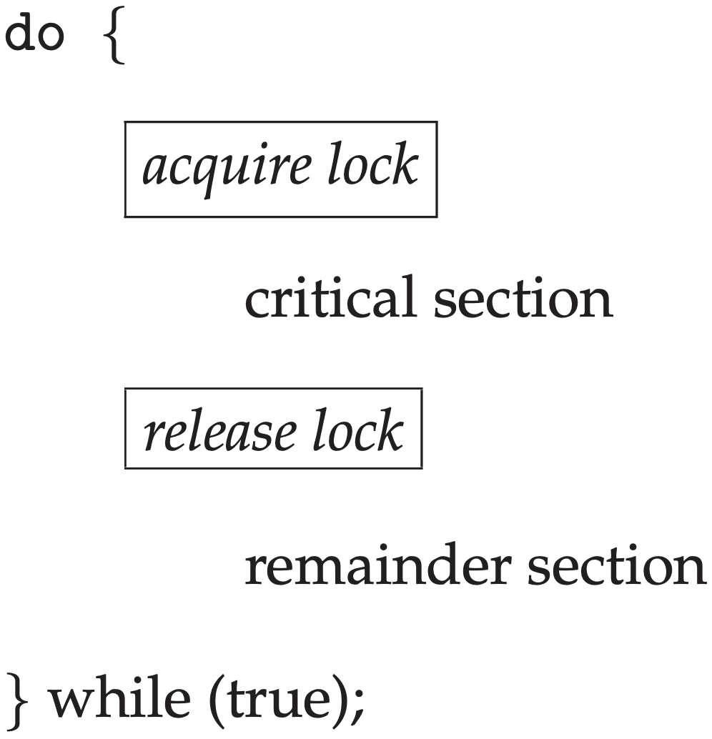
Mutex Lock
mutual exclusion
Use lock to grant access permission of shared variable
Acquire lock before accessing
Release lock after operations on shared variable complete
Notes:
From Operating System Concepts 9th edition: Section 5.5 Mutex Locks
The hardware-based solutions to the critical-section problem presented in Section 5.4 are complicated as well as generally inaccessible to application programmers. Instead, operating-systems designers build software tools to solve the critical-section problem. The simplest of these tools is the mutex lock. (In fact, the term mutex is short for mutual exclusion.) We use the mutex lock to protect critical regions and thus prevent race conditions. That is, a process must acquire the lock before entering a critical section; it releases the lock when it exits the critical section. The acquire()function acquires the lock, and the release() function releases the lock, as illustrated in Figure 5.8.
A mutex lock has a boolean variable available whose value indicates if the lock is available or not. If the lock is available, a call to acquire() succeeds, and the lock is then considered unavailable. A process that attempts to acquire an unavailable lock is blocked until the lock is released.
The definition of acquire() is as follows:
acquire() { while (!available)
; /* busy wait */ available = false;; }
Figure in the content;
The definition of release() is as follows:
release() { available = true;
}
Calls to either acquire() or release() must be performed atomically. Thus, mutex locks are often implemented using one of the hardware mecha- nisms described in Section 5.4, and we leave the description of this technique as an exercise.
The main disadvantage of the implementation given here is that it requires busy waiting. While a process is in its critical section, any other process that tries to enter its critical section must loop continuously in the call to acquire(). In fact, this type of mutex lock is also called a spinlock because the process “spins” while waiting for the lock to become available. (We see the same issue with the code examples illustrating the test and set() instruction and the compare and swap() instruction.) This continual looping is clearly a problem in a real multiprogramming system, where a single CPU is shared among many processes. Busy waiting wastes CPU cycles that some other process might be able to use productively.
Spinlocks do have an advantage, however, in that no context switch is required when a process must wait on a lock, and a context switch may take considerable time. Thus, when locks are expected to be held for short times, spinlocks are useful. They are often employed on multiprocessor systems where one thread can “spin” on one processor while another thread performs its critical section on another processor.
Later in this chapter (Section 5.7), we examine how mutex locks can be used to solve classical synchronization problems. We also discuss how these locks are used in several operating systems, as well as in Pthreads.

Slide 11
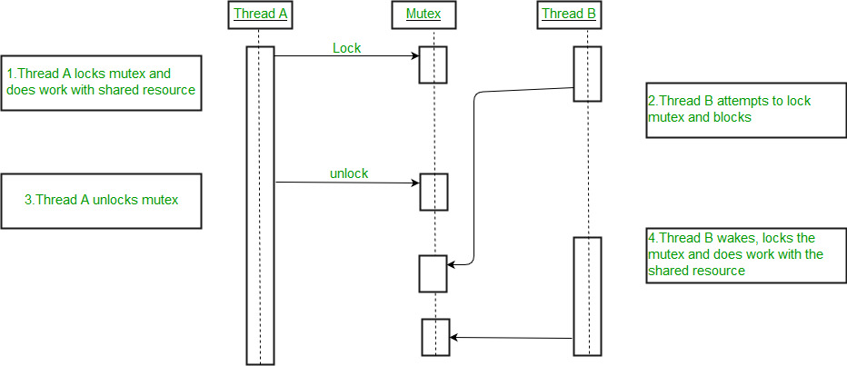
Mutex Lock
mutual exclusion
https://www.geeksforgeeks.org/mutex-lock-for-linux-thread-synchronization/
Notes:
From Operating System Concepts 9th edition: Section 5.5 Mutex Locks
The hardware-based solutions to the critical-section problem presented in Section 5.4 are complicated as well as generally inaccessible to application programmers. Instead, operating-systems designers build software tools to solve the critical-section problem. The simplest of these tools is the mutex lock. (In fact, the term mutex is short for mutual exclusion.) We use the mutex lock to protect critical regions and thus prevent race conditions. That is, a process must acquire the lock before entering a critical section; it releases the lock when it exits the critical section. The acquire()function acquires the lock, and the release() function releases the lock, as illustrated in Figure 5.8.
A mutex lock has a boolean variable available whose value indicates if the lock is available or not. If the lock is available, a call to acquire() succeeds, and the lock is then considered unavailable. A process that attempts to acquire an unavailable lock is blocked until the lock is released.
The definition of acquire() is as follows:
acquire() { while (!available)
; /* busy wait */ available = false;; }
Figure in the content;
The definition of release() is as follows:
release() { available = true;
}
Calls to either acquire() or release() must be performed atomically. Thus, mutex locks are often implemented using one of the hardware mecha- nisms described in Section 5.4, and we leave the description of this technique as an exercise.
The main disadvantage of the implementation given here is that it requires busy waiting. While a process is in its critical section, any other process that tries to enter its critical section must loop continuously in the call to acquire(). In fact, this type of mutex lock is also called a spinlock because the process “spins” while waiting for the lock to become available. (We see the same issue with the code examples illustrating the test and set() instruction and the compare and swap() instruction.) This continual looping is clearly a problem in a real multiprogramming system, where a single CPU is shared among many processes. Busy waiting wastes CPU cycles that some other process might be able to use productively.
Spinlocks do have an advantage, however, in that no context switch is required when a process must wait on a lock, and a context switch may take considerable time. Thus, when locks are expected to be held for short times, spinlocks are useful. They are often employed on multiprocessor systems where one thread can “spin” on one processor while another thread performs its critical section on another processor.
Later in this chapter (Section 5.7), we examine how mutex locks can be used to solve classical synchronization problems. We also discuss how these locks are used in several operating systems, as well as in Pthreads.

Slide 12
how to lock in hardware?

Slide 13
Atomic Exchange
Interchange a value in a register for a value in memory
Consider the value as a lock value 0: lock is free value 1: lock is unavailable

Slide 14
Atomic Exchange
Processor tries to set the lock by an exchange of 1 in a register with the lock defined by its memory address
Exchange returns 1 if some other processor had already claimed access
Exchange returns 0 otherwise and then sets the value as 1 (to prevent any competing exchange from also retrieving a 0)
Notes:
There are a number of other atomic primitives that can be used to implement synchronization. They all have the key property that they read and update a memory value in such a manner that we can tell whether the two operations executed atom- ically. One operation, present in many older multiprocessors, is test-and-set, which tests a value and sets it if the value passes the test. For example, we could define an operation that tested for 0 and set the value to 1, which can be used in a fashion sim- ilar to how we used atomic exchange. Another atomic synchronization primitive is fetch-and-increment: it returns the value of a memory location and atomically incre- ments it. By using the value 0 to indicate that the synchronization variable is unclaimed, we can use fetch-and-increment, just as we used exchange.

Slide 15
Atomic Exchange
Atomic Exchange in RISC-V
Use a pair of instructions where the second instruction returns a value from which it can be deduced whether the pair of instructions was executed as though the instructions were atomic, and all other operations executed by any processor occurred before or after the pair
Load Reservation + Store Conditional
Notes:
There are a number of other atomic primitives that can be used to implement synchronization. They all have the key property that they read and update a memory value in such a manner that we can tell whether the two operations executed atom- ically. One operation, present in many older multiprocessors, is test-and-set, which tests a value and sets it if the value passes the test. For example, we could define an operation that tested for 0 and set the value to 1, which can be used in a fashion sim- ilar to how we used atomic exchange. Another atomic synchronization primitive is fetch-and-increment: it returns the value of a memory location and atomically incre- ments it. By using the value 0 to indicate that the synchronization variable is unclaimed, we can use fetch-and-increment, just as we used exchange.

Slide 16
Load Reservation: lr
lr rd, 0(rs1)
Also called as load linked/locked
Load the contents of memory given by rs1 into rd
Create a reservation on that memory address

Slide 17
Store Conditional: sc
sc rs2/rd, 0(rs1)
← lr rd, 0(rs1)
Store the value in rs2 into the memory address given by rs1
If reservation of load is broken by a write to the same memory location, store conditional fails and writes a nonzero to rd; context switch also fails store conditional;
If it succeeds, store conditional writes 0 (to rs2/rd; rd of sc != rd of lr)

Slide 18
How to Detect?
Store the value in rs2 into the memory address given by rs1
If reservation of load is broken by a write to the same memory location? store conditional fails and writes a nonzero to rd; context switch? also fails store conditional;
If it succeeds, store conditional writes 0

Slide 19
How to Detect?
sc rs2/rd, 0(rs1)
← lr rd, 0(rs1)
Track the address specified by lr in a reserved register [an additional register not shown in lr encoding & other instructions in subsequent examples]
If an interrupt occurs or the cache block matching the reserved address is invalidated, clear the reserved register
If the address of sc matches that in the reserved register, it succeeds; otherwise, it fails

Slide 20
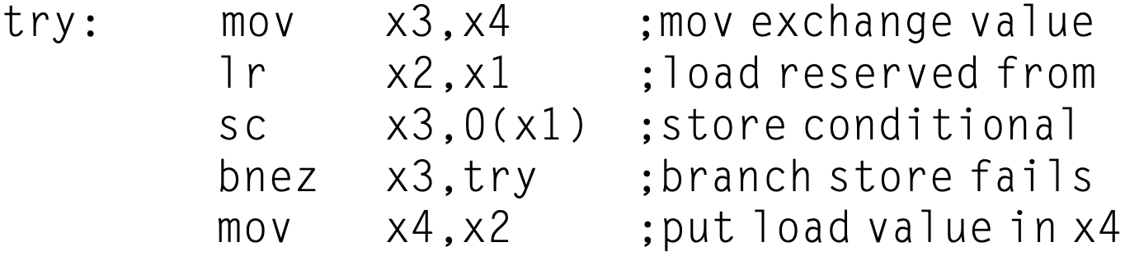
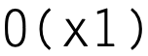
Atomic Exchange Example
Mem[x1] <--> Reg[x4]
Exchange value in Mem[x1] with value in Reg[x4]
Notes:
These instructions are used in sequence, and because the load reserved returns the initial value and the store conditional returns 0 only if it succeeds, the following sequence implements an atomic exchange on the memory location specified by the contents of x1 with the value in x4:
try: mov x3,x4 lr x2,x1
sc x3,0(x1) bnez x3,try mov x4,x2
;mov exchange value ;load reserved from ;store conditional ;branch store fails ;put load value in x4
At the end of this sequence, the contents of x4 and the memory location specified by x1 have been atomically exchanged.
Anytime a processor intervenes and modifies the value in memory between the lr and sc instructions, the sc returns 0 in x3??? [If it succeeds, store conditional writes 0
], causing the code sequence to try again.

Slide 21
Atomic Exchange Example
Mem[x1] <--> Reg[x4]
move value in Reg[x4] to Reg[x3]
Notes:
These instructions are used in sequence, and because the load reserved returns the initial value and the store conditional returns 0 only if it succeeds, the following sequence implements an atomic exchange on the memory location specified by the contents of x1 with the value in x4:
try: mov x3,x4 lr x2,x1
sc x3,0(x1) bnez x3,try mov x4,x2
;mov exchange value ;load reserved from ;store conditional ;branch store fails ;put load value in x4
At the end of this sequence, the contents of x4 and the memory location specified by x1 have been atomically exchanged.
Anytime a processor intervenes and modifies the value in memory between the lr and sc instructions, the sc returns 0 in x3??? [If it succeeds, store conditional writes 0
], causing the code sequence to try again.

Slide 22
Atomic Exchange Example
Mem[x1] <--> Reg[x4]
move value in Reg[x4] to Reg[x3]
load value from Mem[x1] to Reg[x2]
Notes:
These instructions are used in sequence, and because the load reserved returns the initial value and the store conditional returns 0 only if it succeeds, the following sequence implements an atomic exchange on the memory location specified by the contents of x1 with the value in x4:
try: mov x3,x4 lr x2,x1
sc x3,0(x1) bnez x3,try mov x4,x2
;mov exchange value ;load reserved from ;store conditional ;branch store fails ;put load value in x4
At the end of this sequence, the contents of x4 and the memory location specified by x1 have been atomically exchanged.
Anytime a processor intervenes and modifies the value in memory between the lr and sc instructions, the sc returns 0 in x3??? [If it succeeds, store conditional writes 0
], causing the code sequence to try again.

Slide 23
Atomic Exchange Example
Mem[x1] <--> Reg[x4]
move value in Reg[x4] to Reg[x3]
load value from Mem[x1] to Reg[x2]
!!prior to sc, some processor may write to Mem[x1] and clear Reg[x2]
Notes:
These instructions are used in sequence, and because the load reserved returns the initial value and the store conditional returns 0 only if it succeeds, the following sequence implements an atomic exchange on the memory location specified by the contents of x1 with the value in x4:
try: mov x3,x4 lr x2,x1
sc x3,0(x1) bnez x3,try mov x4,x2
;mov exchange value ;load reserved from ;store conditional ;branch store fails ;put load value in x4
At the end of this sequence, the contents of x4 and the memory location specified by x1 have been atomically exchanged.
Anytime a processor intervenes and modifies the value in memory between the lr and sc instructions, the sc returns 0 in x3??? [If it succeeds, store conditional writes 0
], causing the code sequence to try again.

Slide 24
Atomic Exchange Example
Mem[x1] <--> Reg[x4]
!!prior to sc, some processor may write to Mem[x1] and clear Reg[x2]
if this is the case, 0(x1) of sc does not match with Reg[x2] any more; sc fails & writes 1 to x3
Notes:
These instructions are used in sequence, and because the load reserved returns the initial value and the store conditional returns 0 only if it succeeds, the following sequence implements an atomic exchange on the memory location specified by the contents of x1 with the value in x4:
try: mov x3,x4 lr x2,x1
sc x3,0(x1) bnez x3,try mov x4,x2
;mov exchange value ;load reserved from ;store conditional ;branch store fails ;put load value in x4
At the end of this sequence, the contents of x4 and the memory location specified by x1 have been atomically exchanged.
Anytime a processor intervenes and modifies the value in memory between the lr and sc instructions, the sc returns 0 in x3??? [If it succeeds, store conditional writes 0
], causing the code sequence to try again.

Slide 25
Atomic Exchange Example
Mem[x1] <--> Reg[x4]
if this is the case, 0(x1) of sc does not match with Reg[x2] any more; sc fails and writes 1 to x3
otherwise, sc succeeds & writes 0 to x3
Notes:
These instructions are used in sequence, and because the load reserved returns the initial value and the store conditional returns 0 only if it succeeds, the following sequence implements an atomic exchange on the memory location specified by the contents of x1 with the value in x4:
try: mov x3,x4 lr x2,x1
sc x3,0(x1) bnez x3,try mov x4,x2
;mov exchange value ;load reserved from ;store conditional ;branch store fails ;put load value in x4
At the end of this sequence, the contents of x4 and the memory location specified by x1 have been atomically exchanged.
Anytime a processor intervenes and modifies the value in memory between the lr and sc instructions, the sc returns 0 in x3??? [If it succeeds, store conditional writes 0
], causing the code sequence to try again.

Slide 26
Atomic Exchange Example
Mem[x1] <--> Reg[x4]
if sc fails and writes 1 to x3
otherwise, sc succeeds & writes 0 to x3
if Reg[x3]!=0, need to re-try
Notes:
These instructions are used in sequence, and because the load reserved returns the initial value and the store conditional returns 0 only if it succeeds, the following sequence implements an atomic exchange on the memory location specified by the contents of x1 with the value in x4:
try: mov x3,x4 lr x2,x1
sc x3,0(x1) bnez x3,try mov x4,x2
;mov exchange value ;load reserved from ;store conditional ;branch store fails ;put load value in x4
At the end of this sequence, the contents of x4 and the memory location specified by x1 have been atomically exchanged.
Anytime a processor intervenes and modifies the value in memory between the lr and sc instructions, the sc returns 0 in x3??? [If it succeeds, store conditional writes 0
], causing the code sequence to try again.

Slide 27
Atomic Exchange Example
Mem[x1] <--> Reg[x4]
if Reg[x3]!=0, need to re-try
otherwise, sc already succeeded & Reg[x4] has already been written to Mem[x1], just use mov to original value of Mem[x1] (in x2 by lr) to Reg[x4]
Notes:
These instructions are used in sequence, and because the load reserved returns the initial value and the store conditional returns 0 only if it succeeds, the following sequence implements an atomic exchange on the memory location specified by the contents of x1 with the value in x4:
try: mov x3,x4 lr x2,x1
sc x3,0(x1) bnez x3,try mov x4,x2
;mov exchange value ;load reserved from ;store conditional ;branch store fails ;put load value in x4
At the end of this sequence, the contents of x4 and the memory location specified by x1 have been atomically exchanged.
Anytime a processor intervenes and modifies the value in memory between the lr and sc instructions, the sc returns 0 in x3??? [If it succeeds, store conditional writes 0
], causing the code sequence to try again.

Slide 28
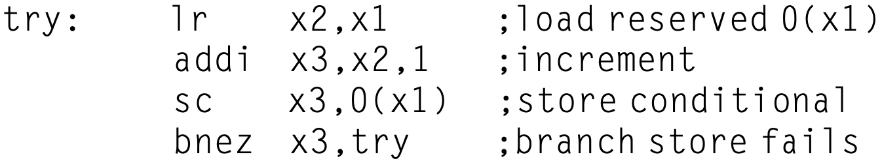
Atomic Fetch-and-Increment
Mem[x1] <-- Mem[x1] + 1
Notes:
The essential goal of the code: Another atomic synchronization primitive is fetch-and-increment: it returns the value of a memory location and atomically increments it.
(potential usage of the code for atomic exchange: By using the value 0 (assume to initialize Mem[x1] as 0?) to indicate that the synchronization variable is unclaimed, we can use fetch-and-increment, just as we used exchange.)

Slide 29
Spin Locks
locks that a processor continuously tries to acquire, spinning around a loop until it succeeds
example spin lock with address in x1 EXCH as a macro for atomic exchange
atomic exchange
if EXCH succeeds, x2 contains lock value;
bnez: if x2 == 0, original lock is available & currently acquired by this thread

Slide 30
Atomic Fetch-and-Increment
atomic exchange
atomically interchange a value in a register
for a value in memory

Slide 31
Atomic Fetch-and-Increment
atomic exchange
atomically interchange a value in a register
for a value in memory
remember cache and cache coherence?
coherence

Slide 32
Spin Locks using Coherence
coherence
Implement spin locks using both atomic operation and coherence mechanism
Cache locks to greatly reduce the time to acquire the lock

Slide 33
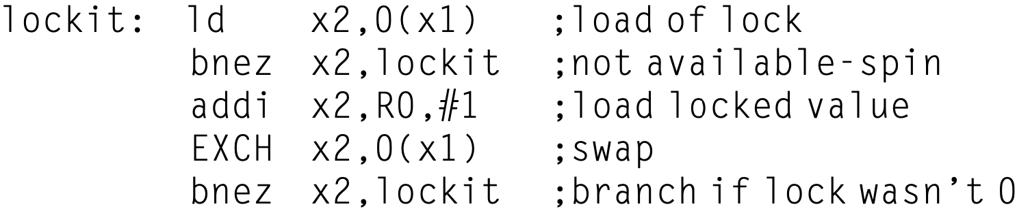
Spin Locks using Coherence
coherence
Implement spin locks using both atomic operation and coherence mechanism
Cache locks to greatly reduce the time to acquire the lock
Notes:
Thus we should modify our spin lock procedure so that it spins by doing reads on a local copy of the lock until it successfully sees that the lock is available. Then it attempts to acquire the lock by doing a swap operation. A processor first reads the lock variable to test its state. A processor keeps reading and testing until the value of the read indicates that the lock is unlocked. The processor then races against all other processes that were similarly “spin waiting” to see which can lock the var- iable first. All processes use a swap instruction that reads the old value and stores a 1 into the lock variable. The single winner will see the 0, and the losers will see a 1 that was placed there by the winner. (The losers will continue to set the variable to the locked value, but that doesn’t matter.) The winning processor executes the code after the lock and, when finished, stores a 0 into the lock variable to release the lock, which starts the race all over again. Here is the code to perform this spin lock (remember that 0 is unlocked and 1 is locked):

Slide 34
Spin Locks using Coherence
coherence
Implement spin locks using both atomic operation and coherence mechanism
Cache locks to greatly reduce the time to acquire the lock
keep local cache reads/hits if nez;
Notes:
Thus we should modify our spin lock procedure so that it spins by doing reads on a local copy of the lock until it successfully sees that the lock is available. Then it attempts to acquire the lock by doing a swap operation. A processor first reads the lock variable to test its state. A processor keeps reading and testing until the value of the read indicates that the lock is unlocked. The processor then races against all other processes that were similarly “spin waiting” to see which can lock the var- iable first. All processes use a swap instruction that reads the old value and stores a 1 into the lock variable. The single winner will see the 0, and the losers will see a 1 that was placed there by the winner. (The losers will continue to set the variable to the locked value, but that doesn’t matter.) The winning processor executes the code after the lock and, when finished, stores a 0 into the lock variable to release the lock, which starts the race all over again. Here is the code to perform this spin lock (remember that 0 is unlocked and 1 is locked):

Slide 35
Spin Locks using Coherence
coherence
Implement spin locks using both atomic operation and coherence mechanism
Cache locks to greatly reduce the time to acquire the lock
if ez, set x2 to 1 & swap it with lock
whose prior value is still 0;
Notes:
Thus we should modify our spin lock procedure so that it spins by doing reads on a local copy of the lock until it successfully sees that the lock is available. Then it attempts to acquire the lock by doing a swap operation. A processor first reads the lock variable to test its state. A processor keeps reading and testing until the value of the read indicates that the lock is unlocked. The processor then races against all other processes that were similarly “spin waiting” to see which can lock the var- iable first. All processes use a swap instruction that reads the old value and stores a 1 into the lock variable. The single winner will see the 0, and the losers will see a 1 that was placed there by the winner. (The losers will continue to set the variable to the locked value, but that doesn’t matter.) The winning processor executes the code after the lock and, when finished, stores a 0 into the lock variable to release the lock, which starts the race all over again. Here is the code to perform this spin lock (remember that 0 is unlocked and 1 is locked):

Slide 36
Spin Locks using Coherence
coherence
Implement spin locks using both atomic operation and coherence mechanism
Cache locks to greatly reduce the time to acquire the lock
if ez, set x2 to 1 & swap it with lock
whose prior value is still 0;
what if another processor wins the race?
Notes:
Thus we should modify our spin lock procedure so that it spins by doing reads on a local copy of the lock until it successfully sees that the lock is available. Then it attempts to acquire the lock by doing a swap operation. A processor first reads the lock variable to test its state. A processor keeps reading and testing until the value of the read indicates that the lock is unlocked. The processor then races against all other processes that were similarly “spin waiting” to see which can lock the var- iable first. All processes use a swap instruction that reads the old value and stores a 1 into the lock variable. The single winner will see the 0, and the losers will see a 1 that was placed there by the winner. (The losers will continue to set the variable to the locked value, but that doesn’t matter.) The winning processor executes the code after the lock and, when finished, stores a 0 into the lock variable to release the lock, which starts the race all over again. Here is the code to perform this spin lock (remember that 0 is unlocked and 1 is locked):

Slide 37
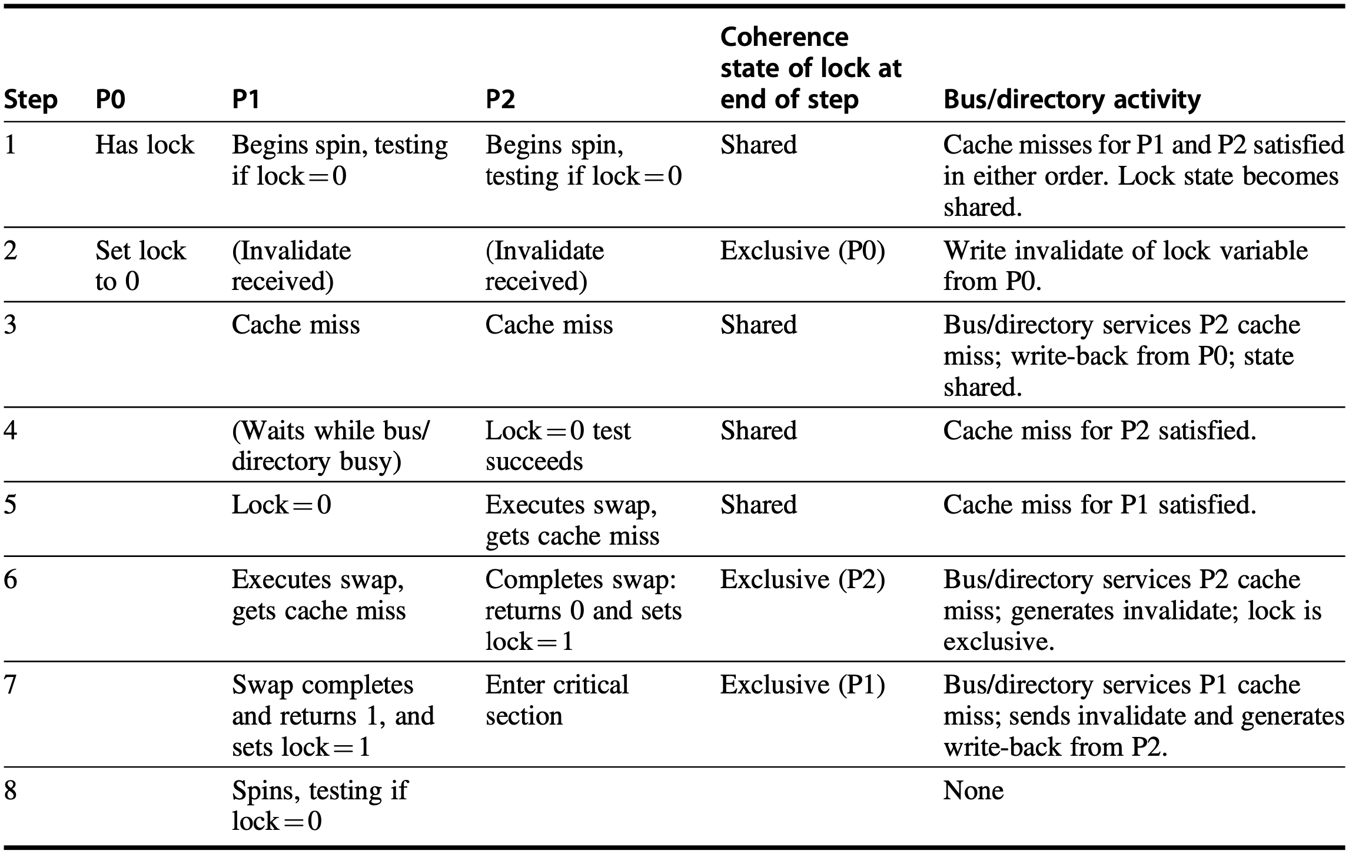
Spin Locks using Coherence
write invalidate
Notes:
Figure5.22 Cache coherence steps and bus traffic for three processors, P0, P1, and P2. This figure assumes write invalidate coherence. P0 starts with the lock (step 1), and the value of the lock is 1 (i.e., locked); it is initially exclu- sive and owned by P0 before step 1 begins. P0 exits and unlocks the lock (step 2). P1 and P2 race to see which reads the unlocked value during the swap (steps 3–5). P2 wins and enters the critical section (steps 6 and 7), while P1’s attempt fails, so it starts spin waiting (steps 7 and 8). In a real system, these events will take many more than 8 clock ticks because acquiring the bus and replying to misses take much longer. Once step 8 is reached, the process can repeat with P2, eventually getting exclusive access and setting the lock to 0.
Let’s examine how this “spin lock” scheme uses the cache coherence mecha- nisms. Figure 5.22 shows the processor and bus or directory operations for multiple processes trying to lock a variable using an atomic swap. Once the processor with the lock stores a 0 into the lock, all other caches are invalidated and must fetch the new value to update their copy of the lock. One such cache gets the copy of the unlocked value (0) first and performs the swap. When the cache miss of other pro- cessors is satisfied, they find that the variable is already locked, so they must return to testing and spinning.

Slide 38
Spin Locks using Coherence
P0 exits and unlocks
lock=1
/modified
Notes:
Figure5.22 Cache coherence steps and bus traffic for three processors, P0, P1, and P2. This figure assumes write invalidate coherence. P0 starts with the lock (step 1), and the value of the lock is 1 (i.e., locked); it is initially exclu- sive and owned by P0 before step 1 begins. P0 exits and unlocks the lock (step 2). P1 and P2 race to see which reads the unlocked value during the swap (steps 3–5). P2 wins and enters the critical section (steps 6 and 7), while P1’s attempt fails, so it starts spin waiting (steps 7 and 8). In a real system, these events will take many more than 8 clock ticks because acquiring the bus and replying to misses take much longer. Once step 8 is reached, the process can repeat with P2, eventually getting exclusive access and setting the lock to 0.
Let’s examine how this “spin lock” scheme uses the cache coherence mecha- nisms. Figure 5.22 shows the processor and bus or directory operations for multiple processes trying to lock a variable using an atomic swap. Once the processor with the lock stores a 0 into the lock, all other caches are invalidated and must fetch the new value to update their copy of the lock. One such cache gets the copy of the unlocked value (0) first and performs the swap. When the cache miss of other pro- cessors is satisfied, they find that the variable is already locked, so they must return to testing and spinning.

Slide 39
Spin Locks using Coherence
P1 and P2 race
Notes:
Figure5.22 Cache coherence steps and bus traffic for three processors, P0, P1, and P2. This figure assumes write invalidate coherence. P0 starts with the lock (step 1), and the value of the lock is 1 (i.e., locked); it is initially exclu- sive and owned by P0 before step 1 begins. P0 exits and unlocks the lock (step 2). P1 and P2 race to see which reads the unlocked value during the swap (steps 3–5). P2 wins and enters the critical section (steps 6 and 7), while P1’s attempt fails, so it starts spin waiting (steps 7 and 8). In a real system, these events will take many more than 8 clock ticks because acquiring the bus and replying to misses take much longer. Once step 8 is reached, the process can repeat with P2, eventually getting exclusive access and setting the lock to 0.
Let’s examine how this “spin lock” scheme uses the cache coherence mecha- nisms. Figure 5.22 shows the processor and bus or directory operations for multiple processes trying to lock a variable using an atomic swap. Once the processor with the lock stores a 0 into the lock, all other caches are invalidated and must fetch the new value to update their copy of the lock. One such cache gets the copy of the unlocked value (0) first and performs the swap. When the cache miss of other pro- cessors is satisfied, they find that the variable is already locked, so they must return to testing and spinning.

Slide 40
Spin Locks using Coherence
P2 wins and enters critical section
Notes:
Figure5.22 Cache coherence steps and bus traffic for three processors, P0, P1, and P2. This figure assumes write invalidate coherence. P0 starts with the lock (step 1), and the value of the lock is 1 (i.e., locked); it is initially exclu- sive and owned by P0 before step 1 begins. P0 exits and unlocks the lock (step 2). P1 and P2 race to see which reads the unlocked value during the swap (steps 3–5). P2 wins and enters the critical section (steps 6 and 7), while P1’s attempt fails, so it starts spin waiting (steps 7 and 8). In a real system, these events will take many more than 8 clock ticks because acquiring the bus and replying to misses take much longer. Once step 8 is reached, the process can repeat with P2, eventually getting exclusive access and setting the lock to 0.
Let’s examine how this “spin lock” scheme uses the cache coherence mecha- nisms. Figure 5.22 shows the processor and bus or directory operations for multiple processes trying to lock a variable using an atomic swap. Once the processor with the lock stores a 0 into the lock, all other caches are invalidated and must fetch the new value to update their copy of the lock. One such cache gets the copy of the unlocked value (0) first and performs the swap. When the cache miss of other pro- cessors is satisfied, they find that the variable is already locked, so they must return to testing and spinning.

Slide 41
Spin Locks using Coherence
P1 fails and spins to wait
Notes:
Figure5.22 Cache coherence steps and bus traffic for three processors, P0, P1, and P2. This figure assumes write invalidate coherence. P0 starts with the lock (step 1), and the value of the lock is 1 (i.e., locked); it is initially exclu- sive and owned by P0 before step 1 begins. P0 exits and unlocks the lock (step 2). P1 and P2 race to see which reads the unlocked value during the swap (steps 3–5). P2 wins and enters the critical section (steps 6 and 7), while P1’s attempt fails, so it starts spin waiting (steps 7 and 8). In a real system, these events will take many more than 8 clock ticks because acquiring the bus and replying to misses take much longer. Once step 8 is reached, the process can repeat with P2, eventually getting exclusive access and setting the lock to 0.
Let’s examine how this “spin lock” scheme uses the cache coherence mecha- nisms. Figure 5.22 shows the processor and bus or directory operations for multiple processes trying to lock a variable using an atomic swap. Once the processor with the lock stores a 0 into the lock, all other caches are invalidated and must fetch the new value to update their copy of the lock. One such cache gets the copy of the unlocked value (0) first and performs the swap. When the cache miss of other pro- cessors is satisfied, they find that the variable is already locked, so they must return to testing and spinning.

Slide 42
Spin Locks using Coherence
lr causes no bus traffic; ld does;
Notes:
Figure5.22 Cache coherence steps and bus traffic for three processors, P0, P1, and P2. This figure assumes write invalidate coherence. P0 starts with the lock (step 1), and the value of the lock is 1 (i.e., locked); it is initially exclu- sive and owned by P0 before step 1 begins. P0 exits and unlocks the lock (step 2). P1 and P2 race to see which reads the unlocked value during the swap (steps 3–5). P2 wins and enters the critical section (steps 6 and 7), while P1’s attempt fails, so it starts spin waiting (steps 7 and 8). In a real system, these events will take many more than 8 clock ticks because acquiring the bus and replying to misses take much longer. Once step 8 is reached, the process can repeat with P2, eventually getting exclusive access and setting the lock to 0.
Let’s examine how this “spin lock” scheme uses the cache coherence mecha- nisms. Figure 5.22 shows the processor and bus or directory operations for multiple processes trying to lock a variable using an atomic swap. Once the processor with the lock stores a 0 into the lock, all other caches are invalidated and must fetch the new value to update their copy of the lock. One such cache gets the copy of the unlocked value (0) first and performs the swap. When the cache miss of other pro- cessors is satisfied, they find that the variable is already locked, so they must return to testing and spinning.

Slide 43
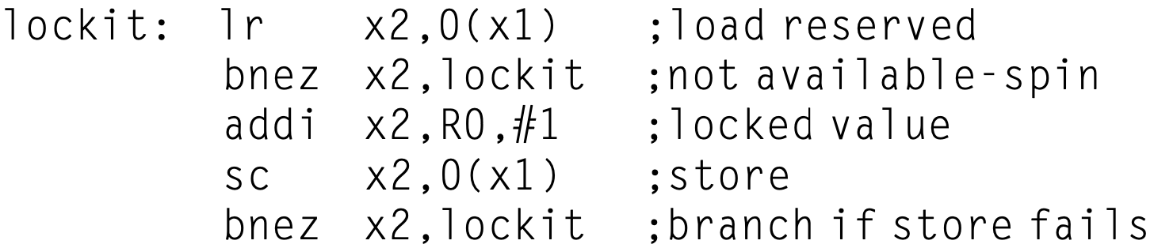
Spin Locks using Coherence
coherence
replace ld with lr for optimizing bandwidth
Notes:
This example shows another advantage of the load reserved/store conditional primitives: the read and write operations are explicitly separated. The load reserved need not cause any bus traffic. This fact allows the following simple code sequence, which has the same characteristics as the optimized version using exchange (x1 has the address of the lock, the lr has replaced the LD, and the sc has replaced the EXCH):
The first branch forms the spinning loop; the second branch resolves races when two processors see the lock available simultaneously.

Slide 44
Synchronized Program
Order all accesses to shared data by synchronization operations
Separate a write of a variable by one processor and a read/write acess of that variable by another processor by a pair of synchronization operations: one afte the write by the writing processor (e.g., unlock); one before the access by the second processor (e.g., lock);

Slide 45
Synchronized Program
data-race-free programm
Data races: variables may be updated without ordering by synchronization, leading to unpredictable execution outcome that depends on the relative speed of the processors;

Slide 46
Synchronized Program
data-race-free programm
Data races: shared data may be updated without ordering by synchronization, leading to unpredictable execution outcome that depends on the relative speed of the processors;
Notes:
More specifically, (of variables) focus more on shared data so far, should be ordered because of dependency

Slide 47
what about unshared data?

Slide 48
should they be ordered?

Slide 49
especially on multiprocessor

Slide 50
Sequential Consistency
Requirement: the result of any execution to be same as though in-order co-processor memory accesses and arbitrarily-interleaved cross-processor memory accesses are enforced

Slide 51
Sequential Consistency
Requirement: the result of any execution to be same as though in-order co-processor memory accesses and arbitrarily-interleaved cross-processor memory accesses are enforced
Notes:
Key is that the result of any execution to be same

Slide 52
Sequential Consistency
require to complete A=1/B=1 before L1/L2
Requirement: the result of any execution to be same as though in-order co-processor memory accesses and arbitrarily-interleaved cross-processor memory accesses are enforced
P1:
L1:
A = 0;
……
A = 1;
if (B == 0)…
P2:
L2:
B = 0;
……
B = 1;
if (A == 0)…
Notes:
Related to the previous example, for this example, if use a design of sequential consistency to ensure program accuracy,
That is, even if various execution ordering of the two program segments on two processors are allowed,
The sequential consistency should ensure that they generate the same result
And to satisfy this requirement, the design principle of the possible sequential consistency should make sure that the assignments must be completed before the IF statements;
Therefore, the content herein is only about the definition of sequential consistency and the goal any of its design should meet,
A specific design of sequential consistency protocol still needs to enforce certain regulations on the ordering of memory accesses, as later examples will show.

Slide 53
Sequential Consistency
Implementation example: delay the completion of any memory access until all the invalidations caused by the access are completed
Notes:
About how to implement

Slide 54
Sequential Consistency
Implementation example: delay the completion of any memory access until all the invalidations caused by the access are completed
Potentially high overhead
Notes:
About how to implement

Slide 55
how to speedup consistency?

Slide 56
Relaxed Consistency
Allow reads and writes to complete out of order
Use synchronization operations to enforce ordering so that a synchronized program behaves as though the processor were sequentially consistent
Notes:
Enforce orderings
How to define ordering

Slide 57
Orderings
X → Y operation X must complete before operation Y
Ordinary orderings: R → W, R → R, W → R, W → W
Synchronization orderings: sync ops versus R/W/syncops
Notes:
Synchronization orderings: two types
Between synchronization operations
Between R/W and synchronization operations

Slide 58
Ordinary Orderings
Sequential consistency: R → W, R → R, W → R, W → W
Total store ordering (processor consistency): relax W → R
Partial store ordering: relax both W → R and W → W
Weak ordering (PowerPC consistency), release consistency (RISC-V consistency): relax all four ordinary orderings

Slide 59
Ordinary Orderings
unshared data
Sequential consistency: R → W, R → R, W → R, W → W
Total store ordering (processor consistency): relax W → R
Partial store ordering: relax both W → R and W → W
Weak ordering (PowerPC consistency), release consistency (RISC-V consistency): relax all four ordinary orderings
Notes:
Otherwise, shared data related to dependency cannot be arbitrarily re-ordered without affecting program accuray

Slide 60
Synchronization Orderings
Sequential consistency, total store ordering, partial store ordering, weak ordering: S → W, S → R, R → S, W → S, S → S where S represents sync operations

Slide 61
Synchronization Orderings
Release consistency: distinguish between sync operations S_{A}: acquire access to a shared variable S_{R}: release an object to allow another processor to aquire access
Access before acquire need not complete before the acquire
Access after release need not wait for the release

Slide 62
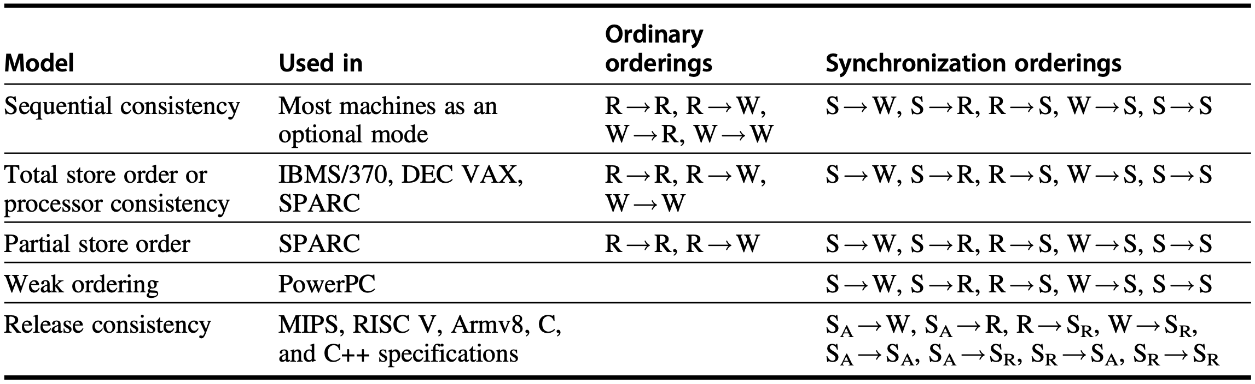
Orderings vs Consistency
Access before acquire need not complete before the acquire
Access after release need not wait for the release
Notes:
Figure 5.23 The orderings imposed by various consistency models are shown for both ordinary accesses and synchronization accesses. The models grow from most restrictive (sequential consistency) to least restrictive (release consistency), allowing increased flexibility in the implementation. The weaker models rely on fences created by synchronization operations, as opposed to an implicit fence at every memory operation. SA and SR stand for acquire and release operations, respectively, and are needed to define release consistency. If we were to use the notation SA and SR for each S consistently, each ordering with one S would become two orderings (e.g., S!W becomes SA!W, SR ! W), and each S ! S would become the four orderings shown in the last line of the bottom-right table entry.

Slide 63
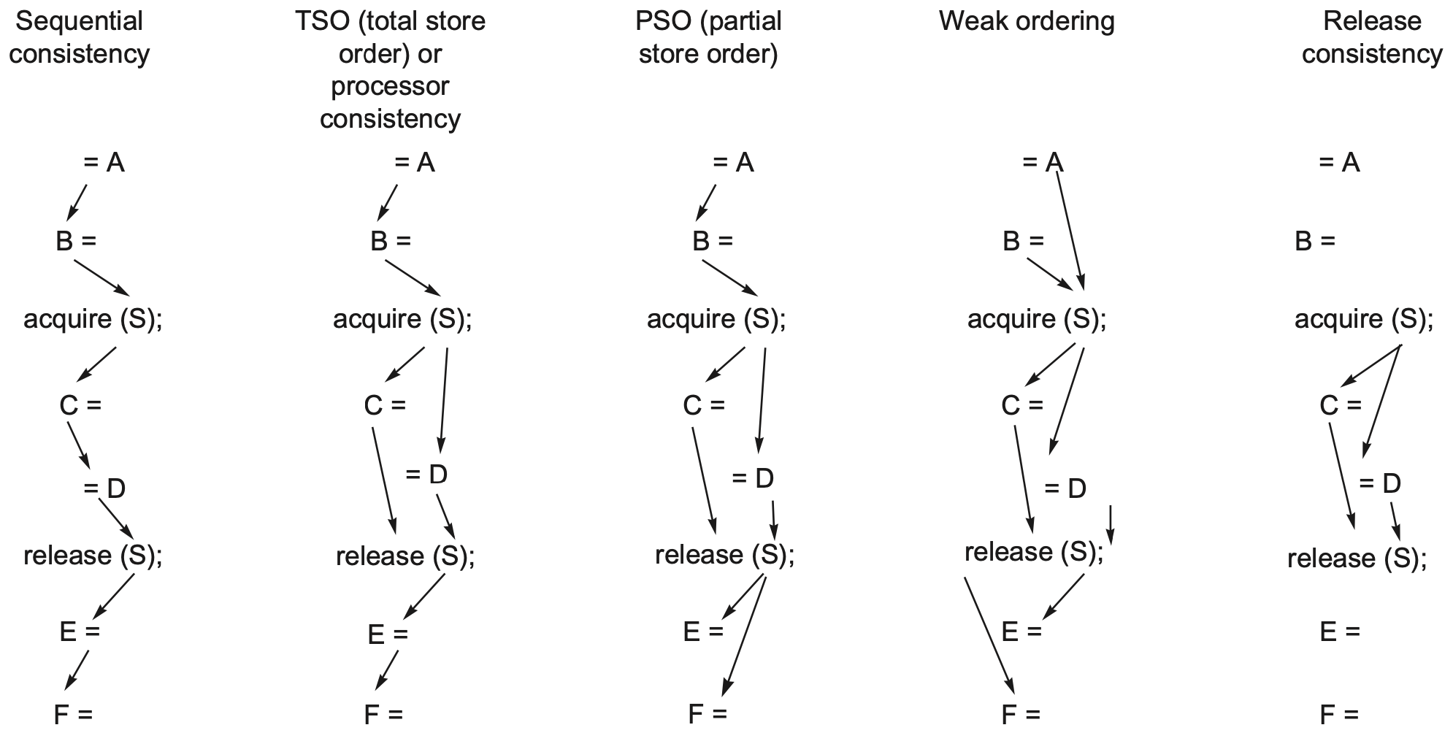
Orderings vs Consistency
Notes:
Figure 5.24 These examples of the five consistency models discussed in this section show the reduction in the number of orders imposed as the models become more relaxed. Only the minimum orders are shown with arrows. Orders implied by transitivity, such as the write of C before the release of S in the sequential consistency model or the acquire before the release in weak ordering or release consistency, are not shown.

Slide 64
Orderings vs Consistency
= Read
Write =
S
W
R
S
W
W
Notes:
Figure 5.24 These examples of the five consistency models discussed in this section show the reduction in the number of orders imposed as the models become more relaxed. Only the minimum orders are shown with arrows. Orders implied by transitivity, such as the write of C before the release of S in the sequential consistency model or the acquire before the release in weak ordering or release consistency, are not shown.

Slide 65
Orderings vs Consistency
enforce all ordinary and synchronization orderings
= Read
Write =
S
W
R
S
W
W
Notes:
Figure 5.24 These examples of the five consistency models discussed in this section show the reduction in the number of orders imposed as the models become more relaxed. Only the minimum orders are shown with arrows. Orders implied by transitivity, such as the write of C before the release of S in the sequential consistency model or the acquire before the release in weak ordering or release consistency, are not shown.

Slide 66
Orderings vs Consistency
relax W → R
= Read
Write =
S
W
R
S
W
W
Notes:
Figure 5.24 These examples of the five consistency models discussed in this section show the reduction in the number of orders imposed as the models become more relaxed. Only the minimum orders are shown with arrows. Orders implied by transitivity, such as the write of C before the release of S in the sequential consistency model or the acquire before the release in weak ordering or release consistency, are not shown.

Slide 67
Orderings vs Consistency
relax W → R and W → W
= Read
Write =
S
W
R
S
W
W
Notes:
Figure 5.24 These examples of the five consistency models discussed in this section show the reduction in the number of orders imposed as the models become more relaxed. Only the minimum orders are shown with arrows. Orders implied by transitivity, such as the write of C before the release of S in the sequential consistency model or the acquire before the release in weak ordering or release consistency, are not shown.

Slide 68
Orderings vs Consistency
enforce only synchronization orderings
= Read
Write =
S
W
R
S
W
W
Notes:
Figure 5.24 These examples of the five consistency models discussed in this section show the reduction in the number of orders imposed as the models become more relaxed. Only the minimum orders are shown with arrows. Orders implied by transitivity, such as the write of C before the release of S in the sequential consistency model or the acquire before the release in weak ordering or release consistency, are not shown.

Slide 69
Orderings vs Consistency
Consistency
enforce only S_{A} → all and all → S_{R}
= Read
Write =
S_{A}
W
R
S_{R}
W
W
Notes:
Figure 5.24 These examples of the five consistency models discussed in this section show the reduction in the number of orders imposed as the models become more relaxed. Only the minimum orders are shown with arrows. Orders implied by transitivity, such as the write of C before the release of S in the sequential consistency model or the acquire before the release in weak ordering or release consistency, are not shown.

Slide 70
relax consistency for efficiency
Consistency

Slide 71
how to gain efficiency
alternatively?

Slide 72
Speculation
Use speculation to hide latency in strict consistency models
Enable out-of-order memory references using dynamic scheduling
Violate sequential consistency / affect program accuracy?

Slide 73
Speculation
Delayed commit: given write invalidate coherence, if the processor receives an invalidation for a uncommitted memory reference, the processor uses speculation recovery to back out of computation, and restart with the memory reference whose address was invalidated

Slide 74
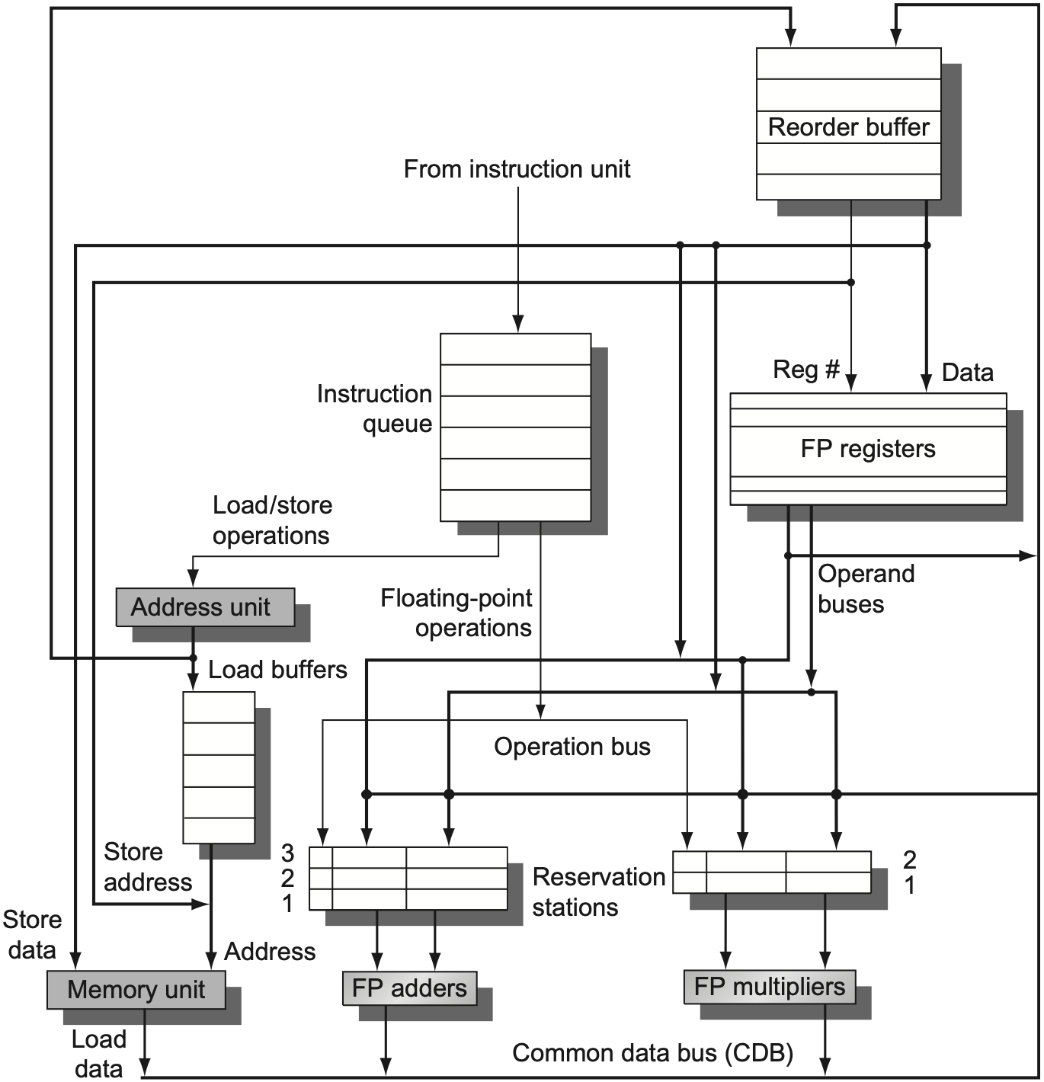
Hardware Speculation
Reorder Buffer (ROB)
Notes:
Figure 3.15 The basic structure of a FP unit using Tomasulo’s algorithm and extended to handle speculation. Comparing this to Figure 3.10 on page 198, which implemented Tomasulo’s algorithm, we can see that the major change is the addition of the ROB and the elimination of the store buffer, whose function is integrated into the ROB. This mechanism can be extended to allow multiple issues per clock by making the CDB wider to allow for mul- tiple completions per clock.

Slide 75
how to gain efficiency more
another resort

Slide 76
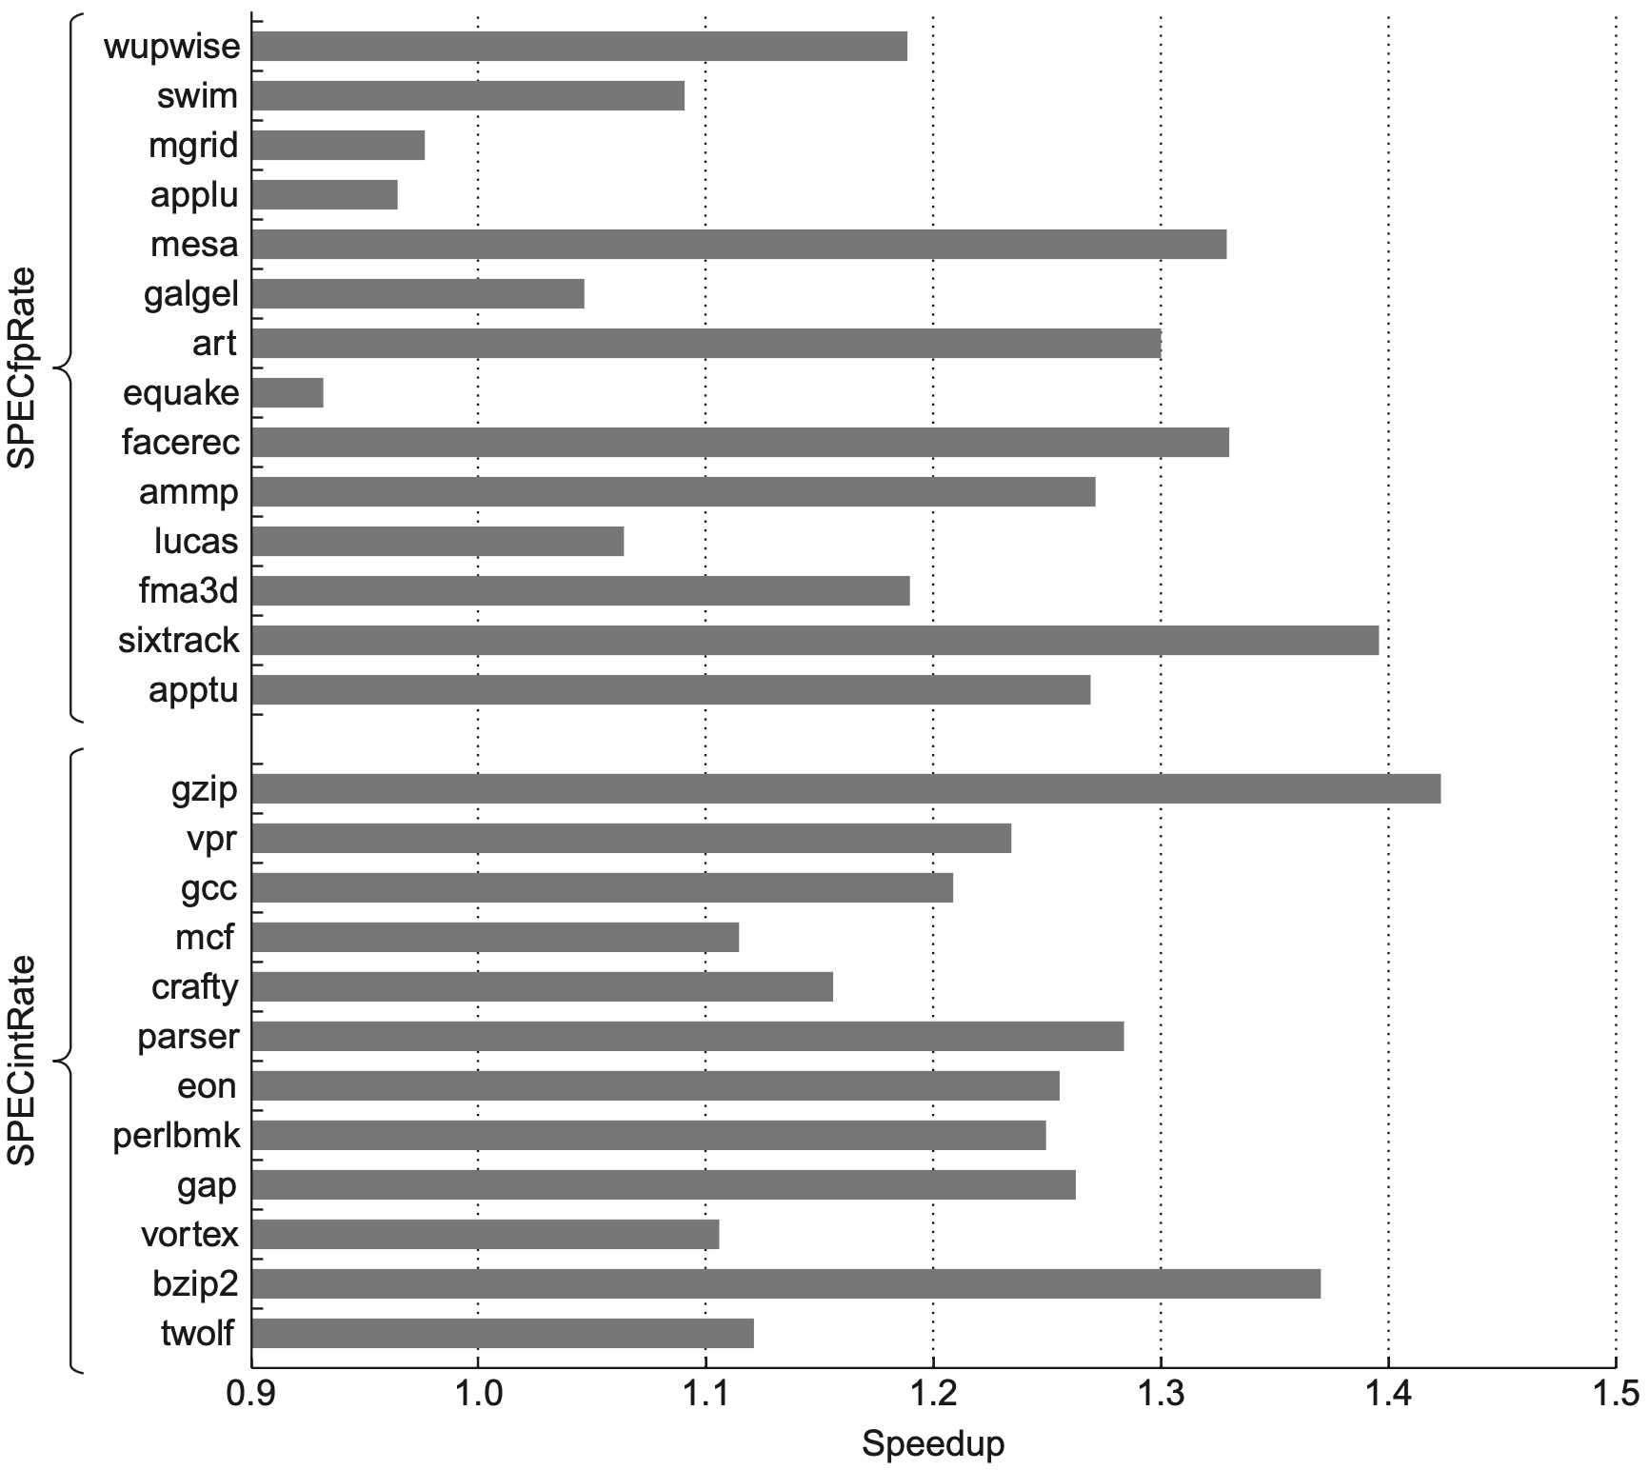
Multithreading
8-processor, dual-core
single-thread per core
vs
dual threads per core
Notes:
Figure 5.25 A comparison of SMT and single-thread (ST) performance on the 8-processor IBM eServer p5 575 using SPECfpRate (top half) and SPECintRate (bottom half) as benchmarks. Note that the x-axis starts at a speedup of 0.9, a performance loss. Only one processor in each Power5 core is active, which should slightly improve the results from SMT by decreasing destructive interference in the memory system. The SMT results are obtained by creating 16 user threads, whereas the ST results use only eight threads; with only one thread per processor, the Power5 is switched to single-threaded mode by the OS. These results were collected by John McCalpin at IBM. As we can see from the data, the standard deviation of the results for the SPECfpRate is higher than for SPECintRate (0.13 versus 0.07), indicating that the SMT improvement for FP programs is likely to vary widely.

Slide 77
Review
Automatic exchange
Lock and spin lock
Sequential consistency
Total store order
Partial store order
Weak ordering
Release consistency

Slide 78
Chapter 5.5-5.7
Notes:
The following content corresponds to chapter 3 (mostly 3.3 – 3.14)
atop the basic working principles of pipelining we have learnt from Appendix C.

Slide 79
?

Slide 80

Thank You
commit to something and commit hard
Thank You
be brave
Notes:
https://twitter.com/jeanqasaur/status/1074526838901202944
复习冲呀

Slide 81

Extraordinary Merry Christmas
Notes:
https://v.qq.com/x/page/q0143lk0koh.html?n_version=2021
tis the season https://music.163.com/#/album?id=151966567

Slide 82
#What’s More
How to Study for Exams - Top 6 Steps for Strategic Exam Preparation Like a Genius
How to Make Stress Your Friend
by Kelly McGonigal
Before Avatar … a curious boy
by James Cameron

